Slide 1

Technical Deep Dive - CSS in Depth – History of CSS
History of CSS
Jonathan Milan Pollock, MS

Slide 2


History of CSS - 1989
1989

Slide 3

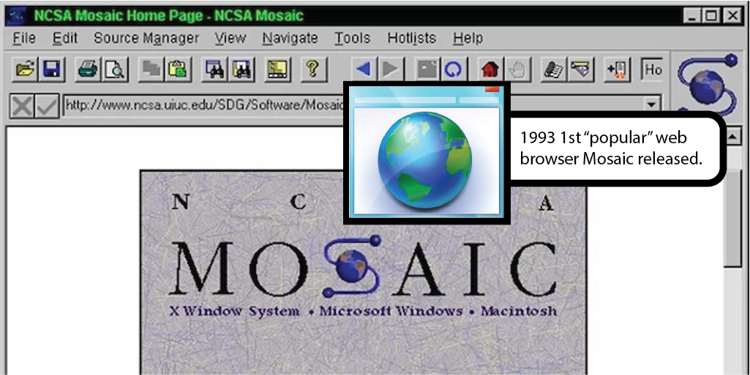

History of CSS - 1993
1993

Slide 4
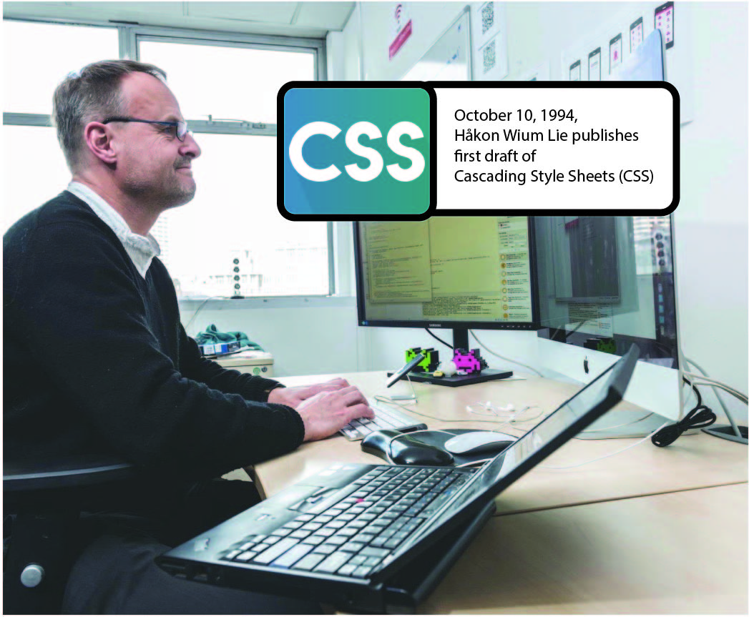
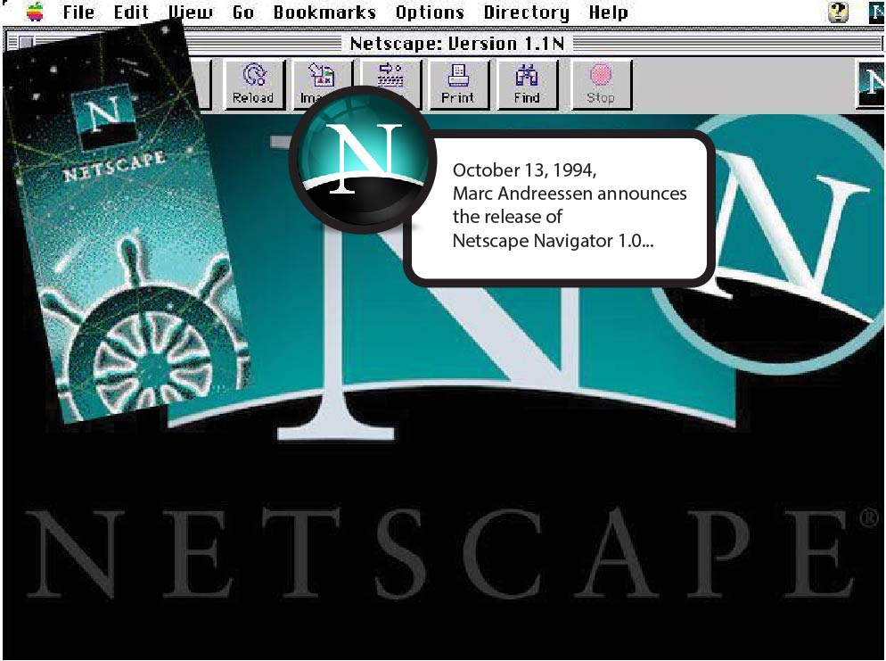
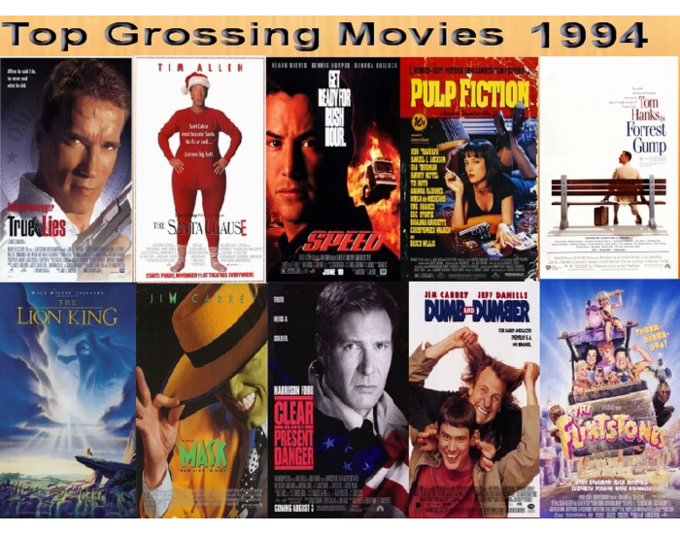
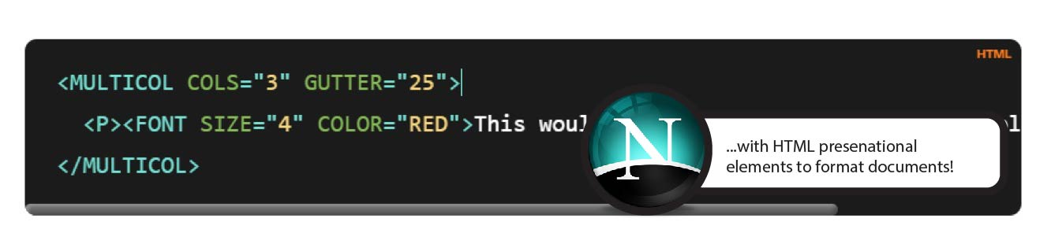
History of CSS - 1994
1994

Slide 5
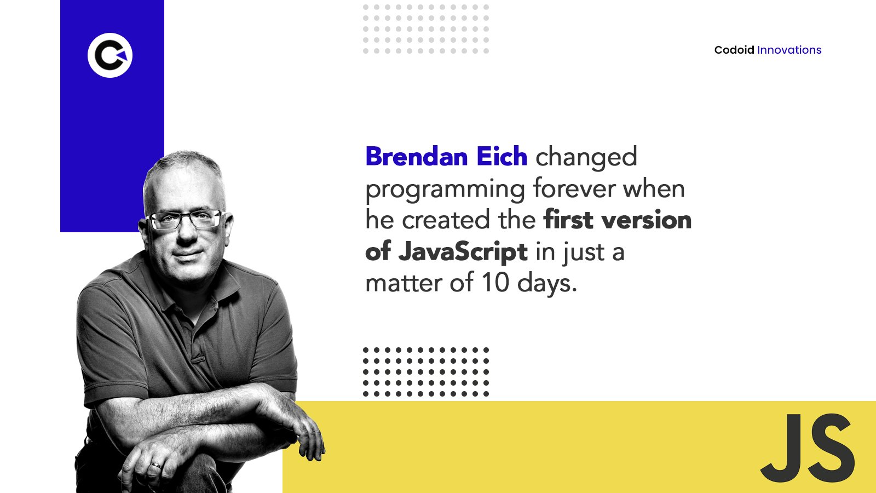

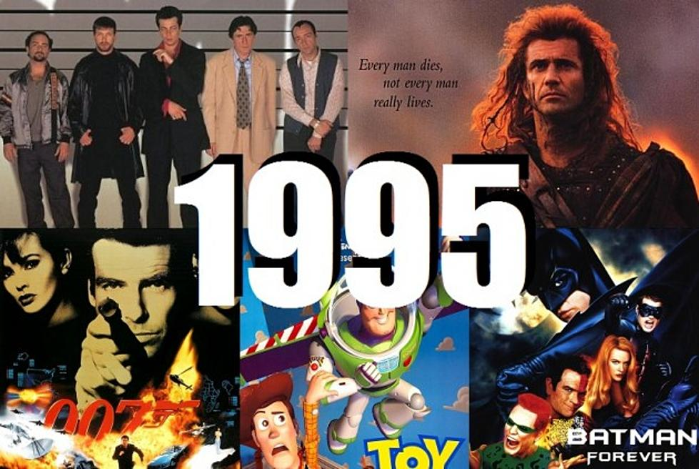
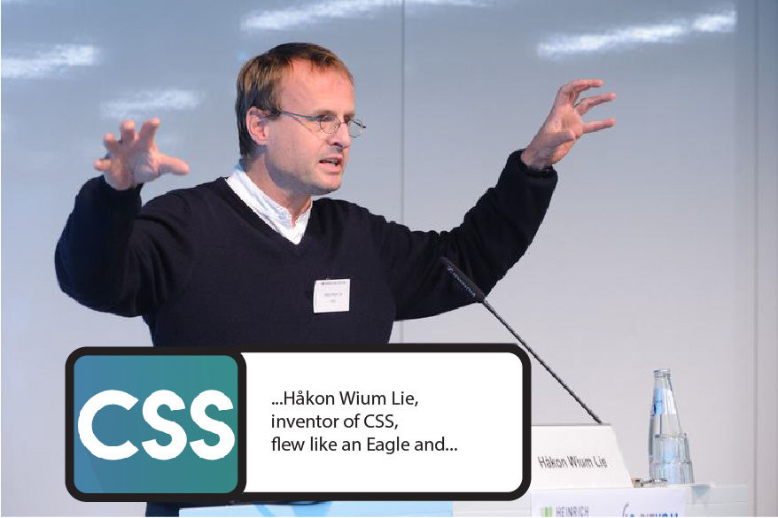

History of CSS - 1995
1995

Slide 6

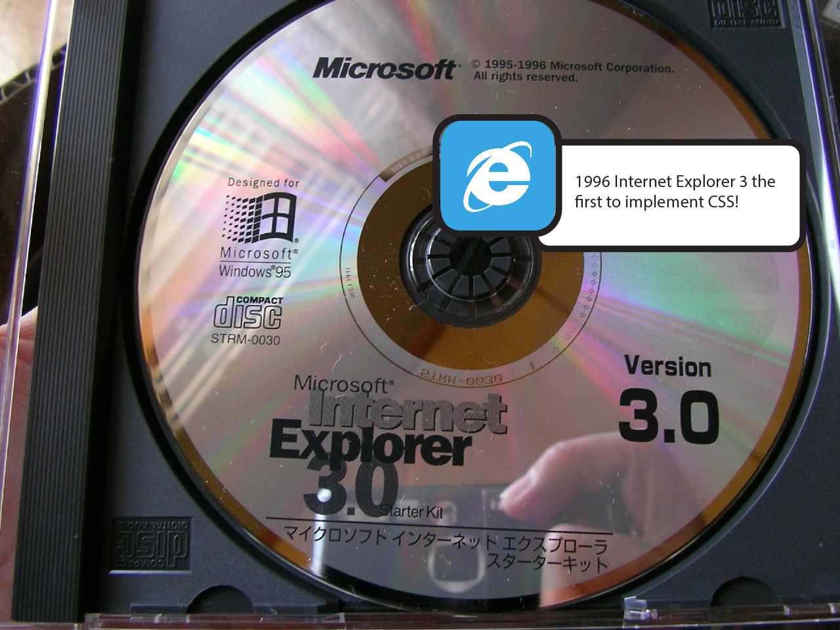
History of CSS - 1996
1996

Slide 7
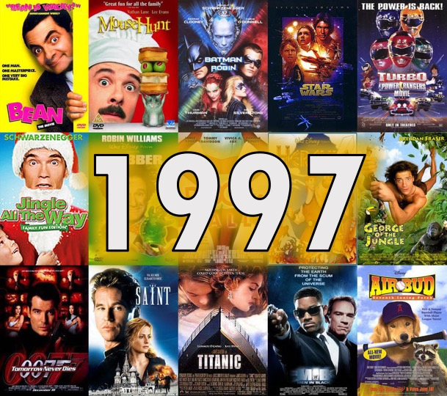

History of CSS - 1997
1997

Slide 8


History of CSS - 1998
1998

Slide 9

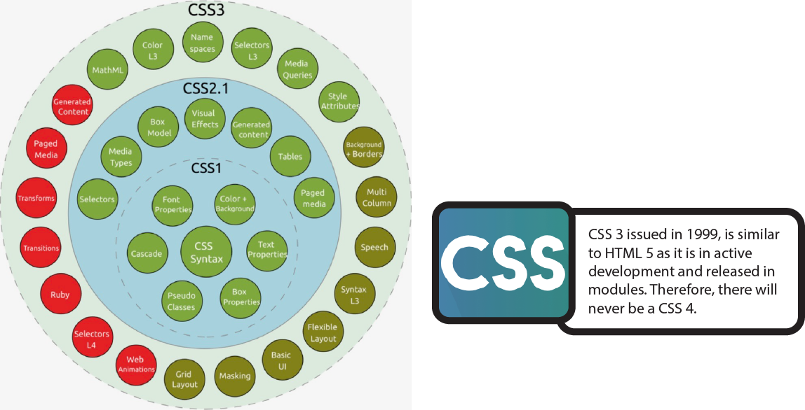
History of CSS - 1999
1999

Slide 10
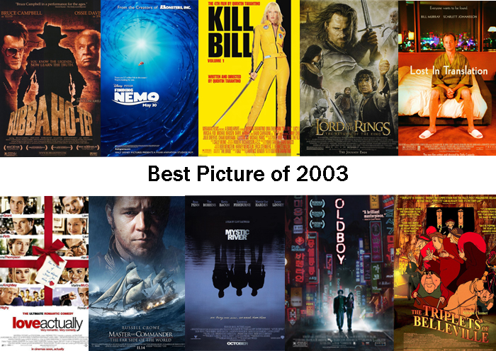
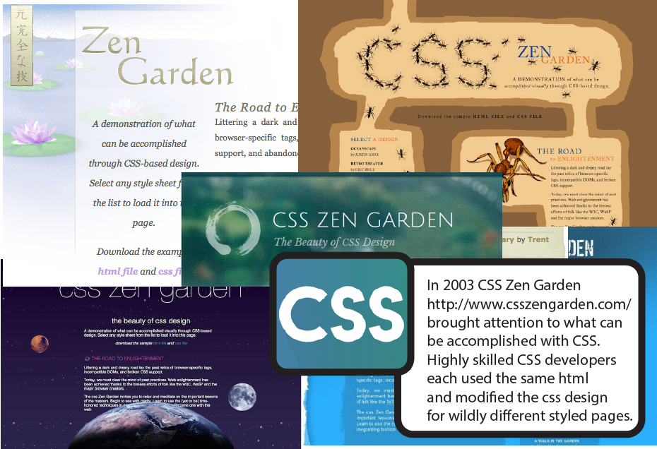
History of CSS - 2003
2003

Slide 11


History of CSS - 2004
2004

Slide 12


History of CSS - 2005
2005

Slide 13
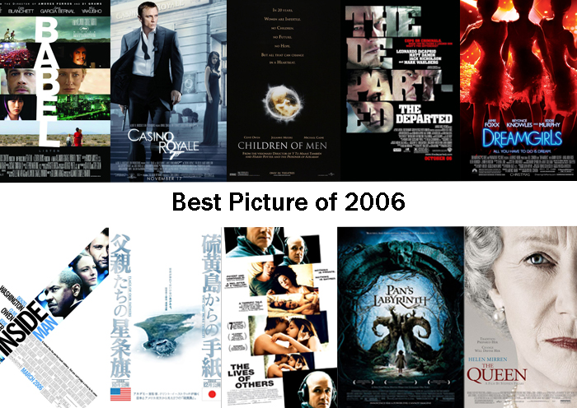

History of CSS - 2006
2006

Slide 14

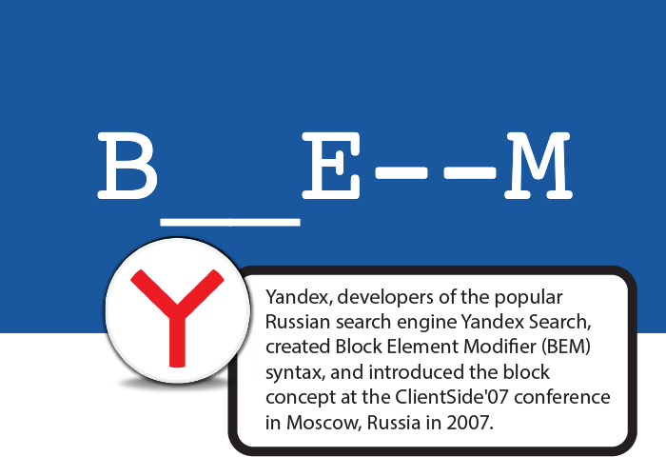
History of CSS - 2007
2007

Slide 15

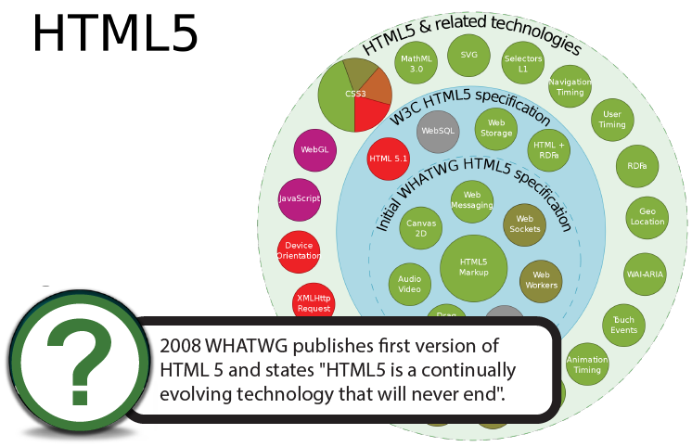
History of CSS - 2008
2008

Slide 16


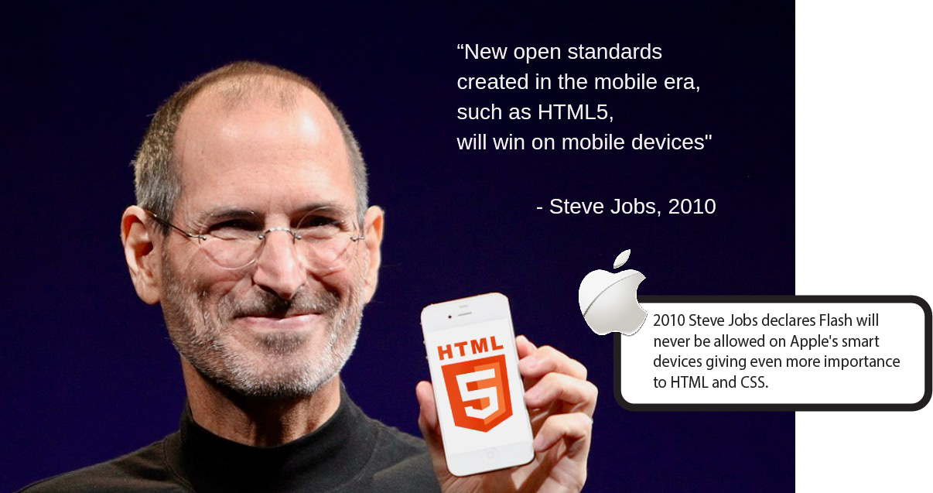
History of CSS - 2010
2010

Slide 17

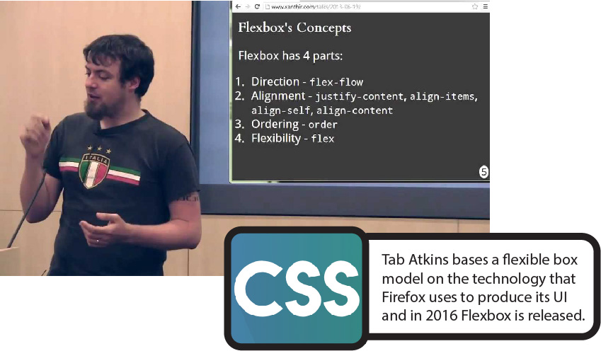
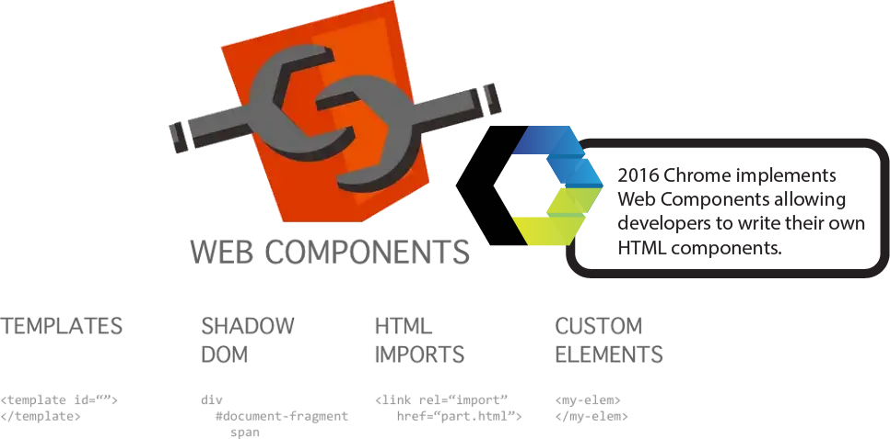
History of CSS - 2016
2016

Slide 18

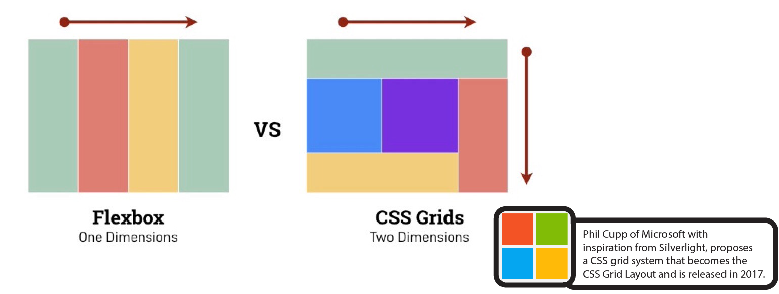
History of CSS - 2017
2017

Slide 19


History of CSS - 2021
2021

Slide 20


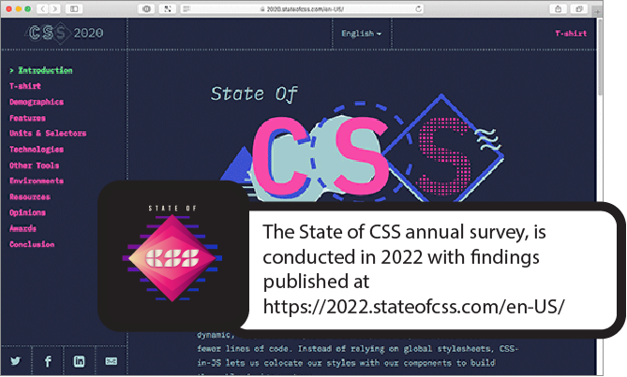
History of CSS - 2022
2022

Slide 21

History of CSS - 2023
2023
…Check back next year to find out changes in CSS History for 2023!

